Slide 1
JavaFX Basic
Part 1

Slide 2
Objectives
To distinguish between JavaFX, Swing, and AWT
To write a simple JavaFX program and understand the relationship among stages, scenes, and nodes
To create user interfaces using panes, UI controls, and shapes
To layout nodes using Pane, StackPane, FlowPane, GridPane, BorderPane, HBox, and VBox

Slide 3
Motivations
JavaFX is a new framework for developing Java GUI programs.
The JavaFX API is an excellent example of how the object-oriented principle is applied.
This chapter serves two purposes.
First, it presents the basics of JavaFX programming.
Second, it uses JavaFX to demonstrate OOP.
Specifically, this chapter introduces the framework of JavaFX and discusses JavaFX GUI components and their relationships.

Slide 4
Introduction
There are two sets of Java APIs for graphics programming:
AWT (Abstract Windowing Toolkit) and
Swing
AWT API was introduced in JDK 1.0. Most of the AWT components have become obsolete and should be replaced by newer Swing components.
Swing API, a much more comprehensive set of graphics libraries that enhances the AWT, was introduced as part of Java Foundation Classes (JFC) after the release of JDK 1.1.
JFC consists of Swing, Java2D, Accessibility, Internationalization, and Pluggable Look-and-Feel Support APIs. JFC was an add-on to JDK 1.1 but has been integrated into core Java since JDK 1.2.

Slide 5
JavaFX
JavaFX is a software platform for creating and delivering desktop applications, as well as rich internet applications (RIAs) that can run across a wide variety of devices.
JavaFX is intended to replace Swing as the standard GUI library for Java SE, but both will be included for the foreseeable future.

Slide 6
JavaFX vs Swing and AWT
Swing and AWT are replaced by the JavaFX platform for developing rich Internet applications.
When Java was introduced, the GUI classes were bundled in a library known as the Abstract Windows Toolkit (AWT).
AWT is fine for developing simple graphical user interfaces, but not for developing comprehensive GUI projects. In addition, AWT is likely to platform-specific bugs.
The AWT user-interface components were replaced by a more robust, versatile, and flexible library known as Swing components.
Swing components are painted directly on canvases using Java code.

Slide 7
Programming GUI with AWT
Java Graphics APIs - AWT and Swing - provide a huge set of reusable GUI components, such as:
Button
text field label,
choice,
panel and
frame
for building GUI applications.

Slide 8
AWT Packages
AWT is huge! It consists of 12 packages
Swing is even bigger, with 18 packages as of JDK 1.7!.
Fortunately, only 2 packages - java.awt andjava.awt.event - are commonly-used.
The java.awt package contains the core AWT graphics classes:
GUI Component classes (such as Button, TextField, and Label),
GUI Container classes (such as Frame, Panel, Dialog and ScrollPane),
Layout managers (such as FlowLayout, BorderLayout and GridLayout),
Custom graphics classes (such as Graphics, Color and Font).
The java.awt.event package supports event handling:
Event classes (such as ActionEvent, MouseEvent, KeyEvent and WindowEvent),
Event Listener Interfaces (such as ActionListener, MouseListener, KeyListener and WindowListener),
Event Listener Adapter classes (such as MouseAdapter, KeyAdapter, and WindowAdapter).
AWT provides a platform-independent and device-independent interface to develop graphic programs that runs on all platforms, such as Windows, Mac, and Linux.

Slide 9
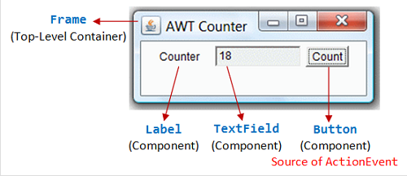
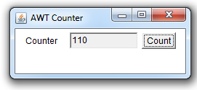
import java.awt.*; // Using AWT container and component classes import java.awt.event.*; // Using AWT event classes and listener interfaces // An AWT program inherits from the top-level container java.awt.Frame public class AWTCounter extends Frame implements ActionListener { private Label lblCount; // Declare component Label private TextField tfCount; // Declare component TextField private Button btnCount; // Declare component Button private int count = 0; // Counter's value /** Constructor to setup GUI components and event handling */ public AWTCounter () { setLayout(new FlowLayout()); // "super" Frame sets its layout to FlowLayout, which arranges the components // from left-to-right, and flow to next row from top-to-bottom. lblCount = new Label("Counter"); // construct Label add(lblCount); // "super" Frame adds Label tfCount = new TextField("0", 10); // construct TextField tfCount.setEditable(false); // set to read-only add(tfCount); // "super" Frame adds tfCount btnCount = new Button("Count"); // construct Button add(btnCount); // "super" Frame adds Button btnCount.addActionListener(this); // Clicking Button source fires ActionEvent // btnCount registers this instance as ActionEvent listener setTitle("AWT Counter"); // "super" Frame sets title setSize(250, 100); // "super" Frame sets initial window size // System.out.println(this); // System.out.println(lblCount); // System.out.println(tfCount); // System.out.println(btnCount);
setVisible(true); // "super" Frame shows
// System.out.println(this); // System.out.println(lblCount); // System.out.println(tfCount); // System.out.println(btnCount);
}
/** The entry main() method */ public static void main(String[] args) { // Invoke the constructor to setup the GUI, by allocating an instance AWTCounter app = new AWTCounter(); } /** ActionEvent handler - Called back upon button-click. */ public void actionPerformed(ActionEvent evt) { ++count; // increase the counter value // Display the counter value on the TextField tfCount tfCount.setText(count + ""); // convert int to String } }
Output
Example: AWT Counter

Slide 10
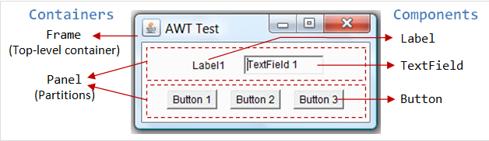
Containers and Components
There are two types of GUI elements:
Component: Components are elementary GUI entities (such asButton, Label, and TextField.)
Container: Containers (such as Frame, Panel and Applet) are used to hold components in a specific layout (such as flow or grid). A container can also hold sub-containers.
GUI components are also called controls (Microsoft ActiveX Control),widgets (Eclipse's Standard Widget Toolkit, Google Web Toolkit), which allow users to interact with (i.e., control) the application through these components (such as button-click and text-entry).

Slide 11
Basic Structure of JavaFX
Application
Override the start(Stage) method
Stage, Scene, and Nodes
MyJavaFX
Run
MultipleStageDemo
Run

Slide 12
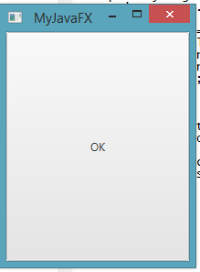
My JavaFx
MultipleStage Demo
import javafx.application.Application; import javafx.scene.Scene; import javafx.scene.control.Button; import javafx.stage.Stage; public class MultipleStageDemo extends Application { @Override // Override the start method in the Application class public void start(Stage primaryStage) { // Create a scene and place a button in the scene Scene scene = new Scene(new Button("OK"), 200, 250); primaryStage.setTitle("MyJavaFX"); // Set the stage title primaryStage.setScene(scene); // Place the scene in the stage primaryStage.show(); // Display the stage Stage stage = new Stage(); // Create a new stage stage.setTitle("Second Stage"); // Set the stage title // Set a scene with a button in the stage stage.setScene(new Scene(new Button("New Stage"), 100, 100)); stage.show(); // Display the stage } /** * The main method is only needed for the IDE with limited * JavaFX support. Not needed for running from the command line. */ //public static void main(String[] args) { // launch(args); // } }
import javafx.application.Application; import javafx.scene.Scene; import javafx.scene.control.Button; import javafx.stage.Stage; public class MyJavaFX extends Application { @Override // Override the start method in the Application class public void start(Stage primaryStage) { // Create a button and place it in the scene Button btOK = new Button("OK"); Scene scene = new Scene(btOK, 200, 250); primaryStage.setTitle("MyJavaFX"); // Set the stage title primaryStage.setScene(scene); // Place the scene in the stage primaryStage.show(); // Display the stage } /** * The main method is only needed for the IDE with limited * JavaFX support. Not needed for running from the command line. */ public static void main(String[] args) { launch(args); } }

Slide 13
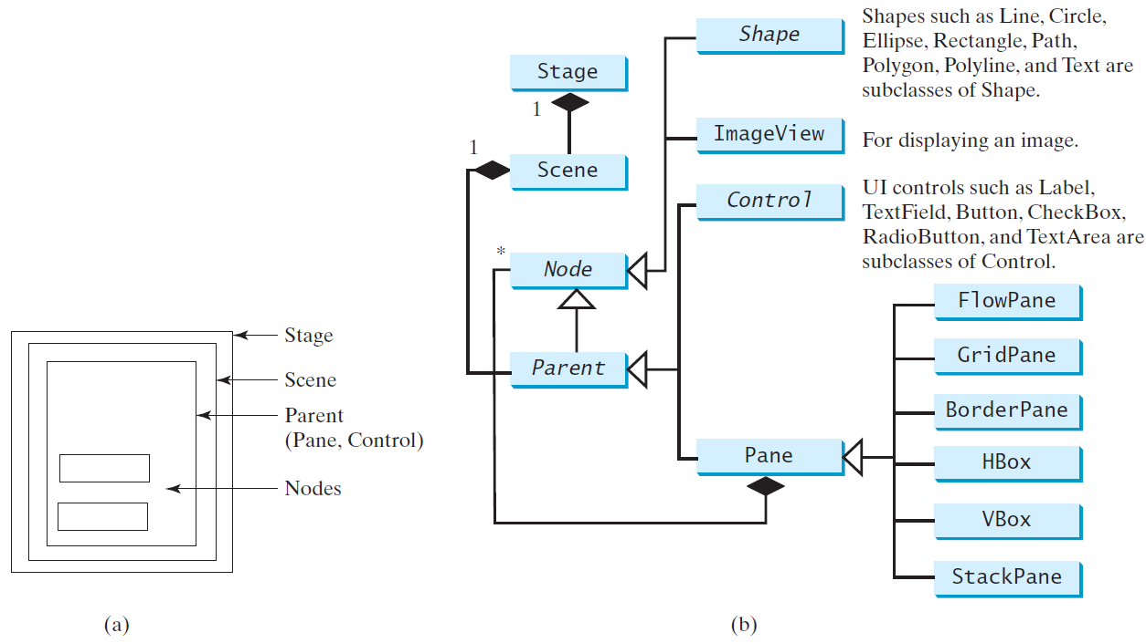
Panes, UI Controls, and Shapes
ButtonInPane
Run

Slide 14
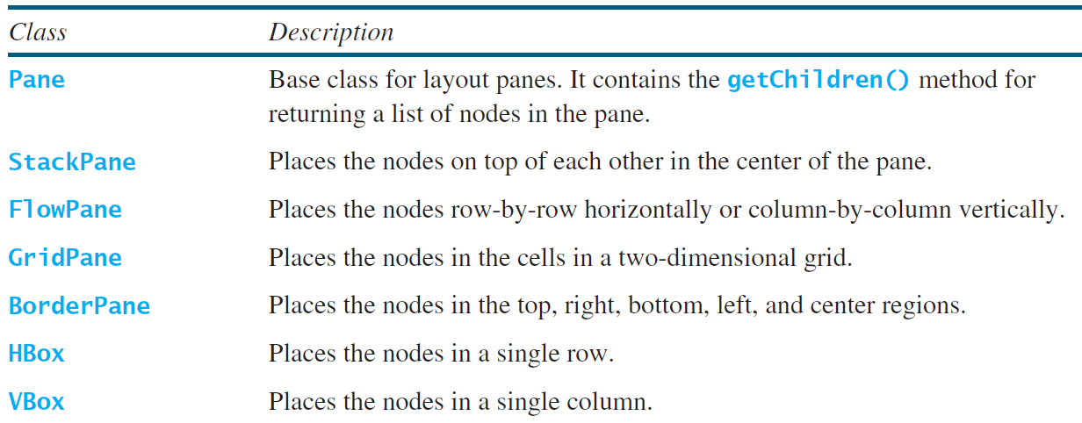
Layout Panes
JavaFX provides many types of panes for organizing nodes in a container.

Slide 15
FlowPane
FlowPane arranges the nodes in the pane horizontally from left to right, or vertically from top to bottom, in the order in which they were added.
The nodes are placed horizontally or vertically using Orientation.HORIZONTAL or Orientation.VERTICAL

Slide 16
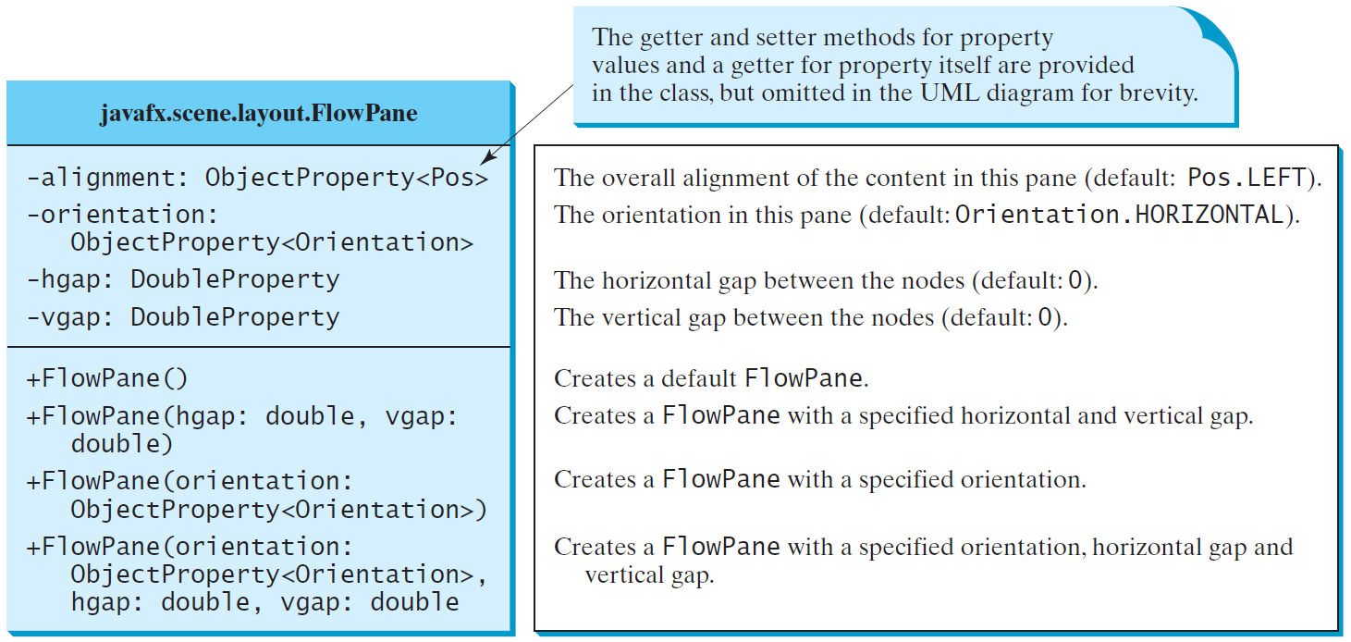
FlowPane
ShowFlowPane
Run

Slide 17

GridPane
GridPane arranges nodes in grid formation. The nodes are placed in the specified column and row indices.
The cell positions in the GridPane

Slide 18
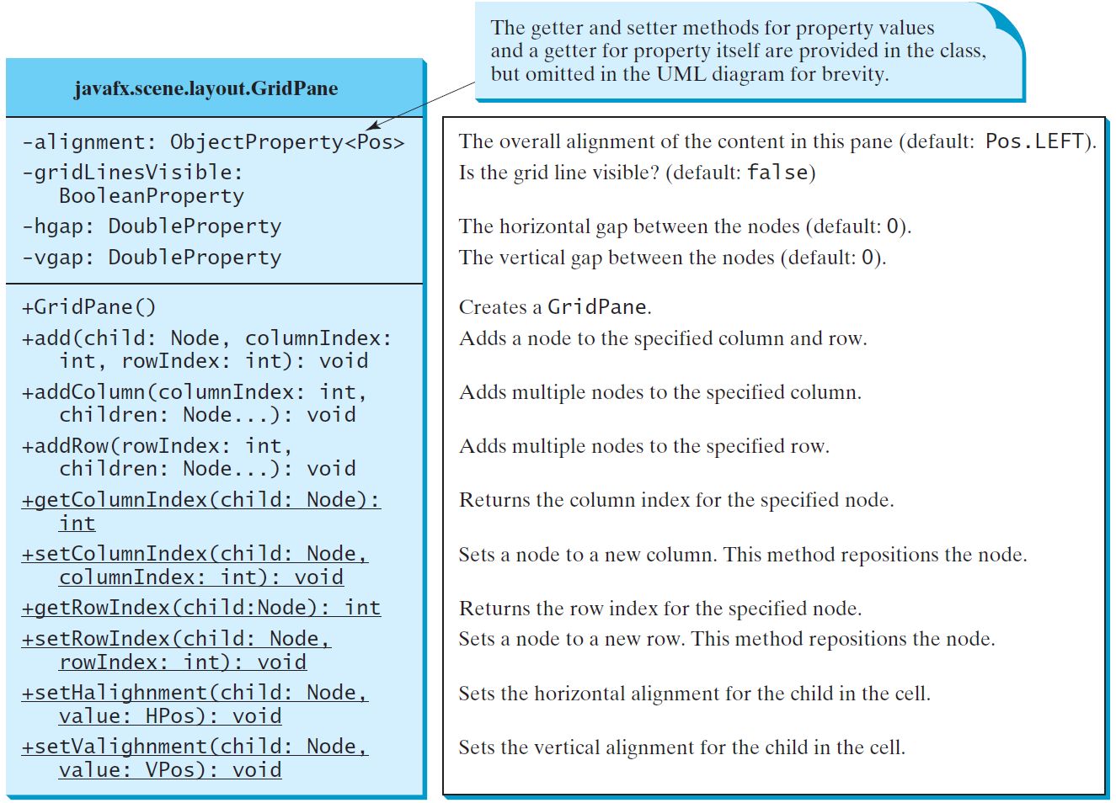
GridPane
ShowGridPane
Run

Slide 19
BorderPane
BorderPane can place nodes in five region:top, bottom, right, left, and center using the setTop(node), setBottom(node), setLeft(node), setRight(node), and setCenter(node) methods.

Slide 20
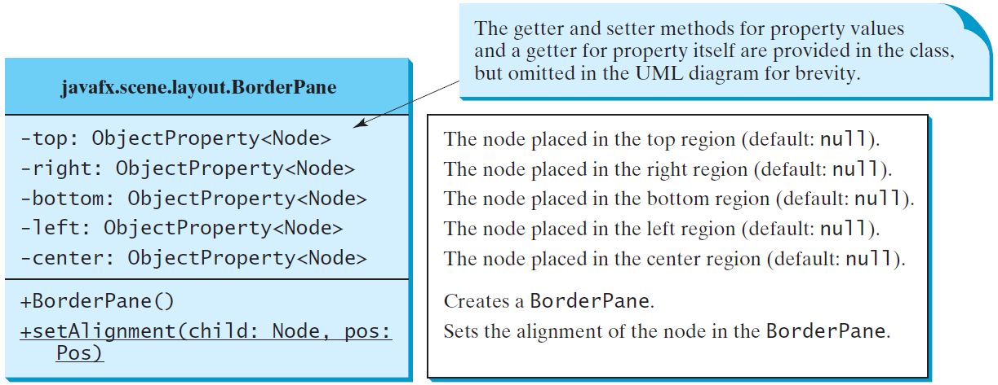
BorderPane
ShowBorderPane
Run

Slide 21
HBox and VBox
HBox lays out its children in a single horizontal row. A VBox lays out its children in a single vertical column.

Slide 22
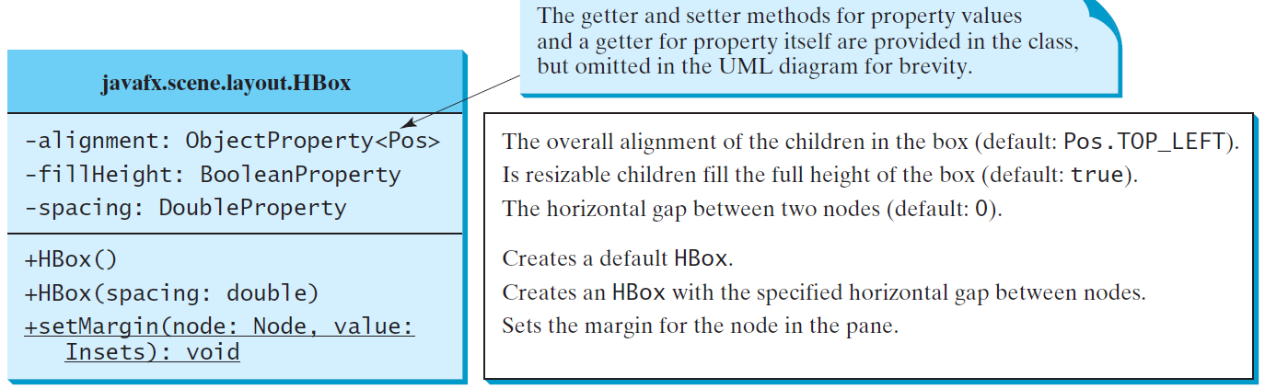
HBox

Slide 23
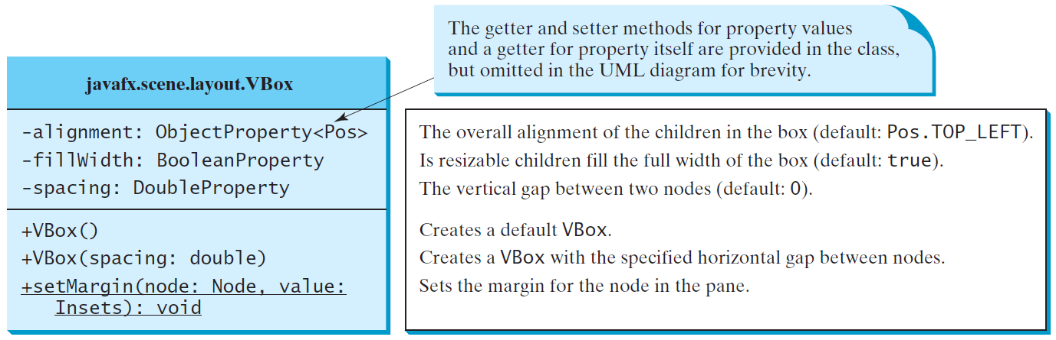
VBox
ShowHBoxVBox
Run

